Slide 1



WHAT YOU CAN DO
Tips for redesign and use of space
Mayra Alvarado, Marian Oppong, Sadhana Jagannath
Small Space Hacks Workshop
6 November 2025 10am-2.30pm

Slide 2
Perception Hacks
Smaller appliances and fixtures
‘Lighter’ furniture
Mirrors to improve depth and lighting
‘Light and Airy’ colour scheme
Proportions and visual emphasis
Movable Furniture
Innovative Storage solutions
Using corners and spaces of the home not otherwise used/occupied
Open-plans and partitions
integrated with building structure
Dedicating activities to spaces for different times of the day
Space/ Storage Hacks
Structural/Layout Hacks
Temporal Hacks

Slide 3
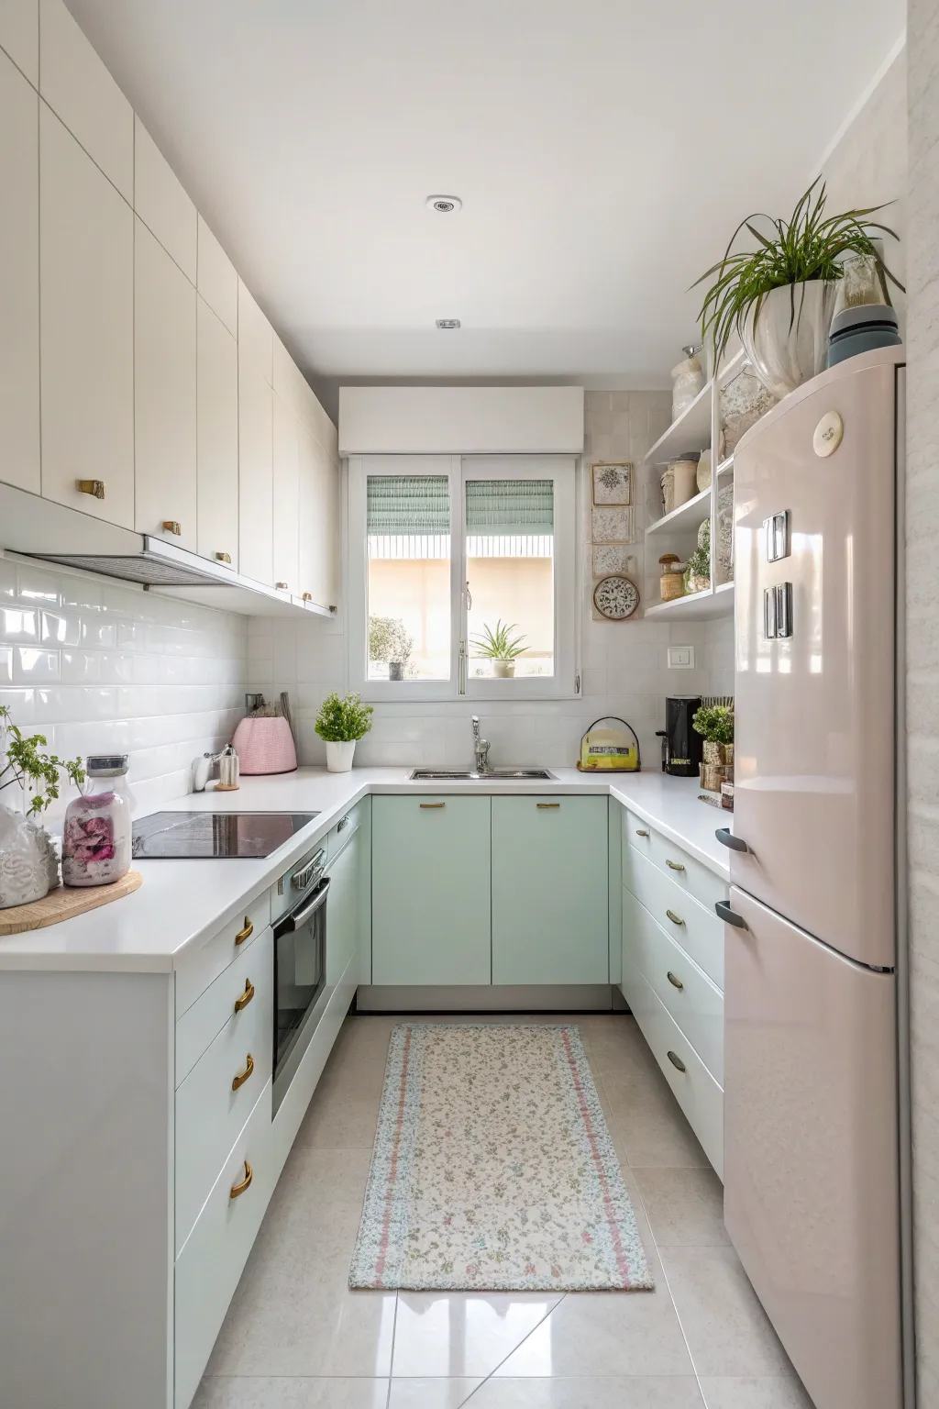
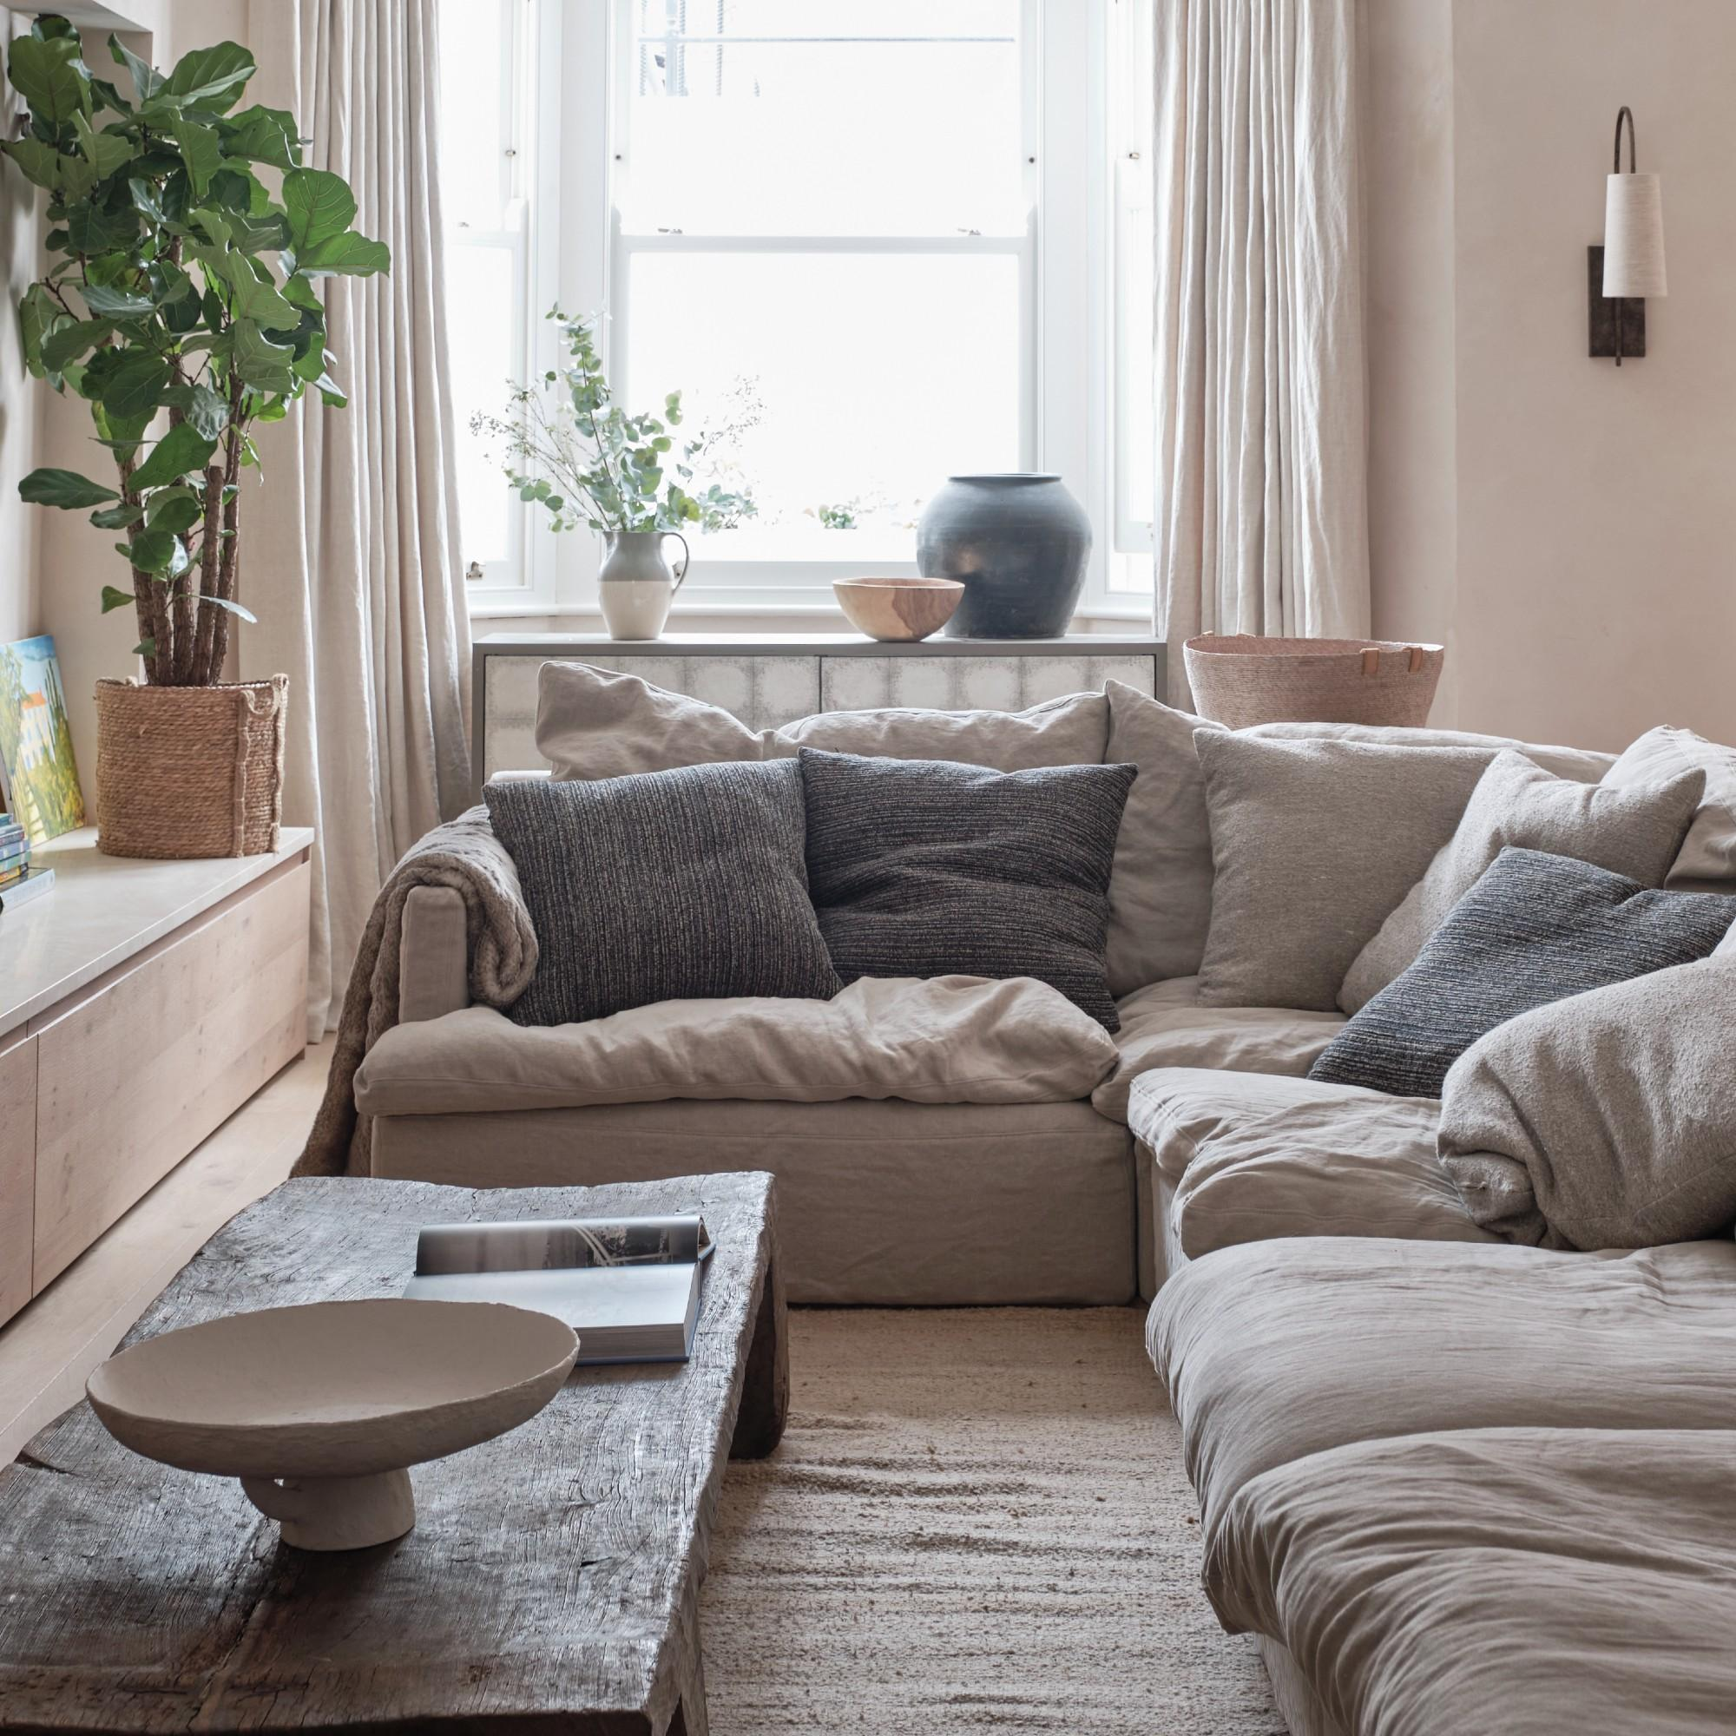
Perception Hacks
Smaller appliances and fixtures, ‘Lighter’ furniture, Mirrors to improve depth and lighting, ‘Light and Airy’ colour scheme
https://casolia.com/small-u-shaped-kitchen-ideas/
(Image credit: Future PLC/James Merrell); https://www.idealhome.co.uk/living-room/living-room-ideas/how-to-make-a-small-living-room-look-bigger-310651

Slide 4
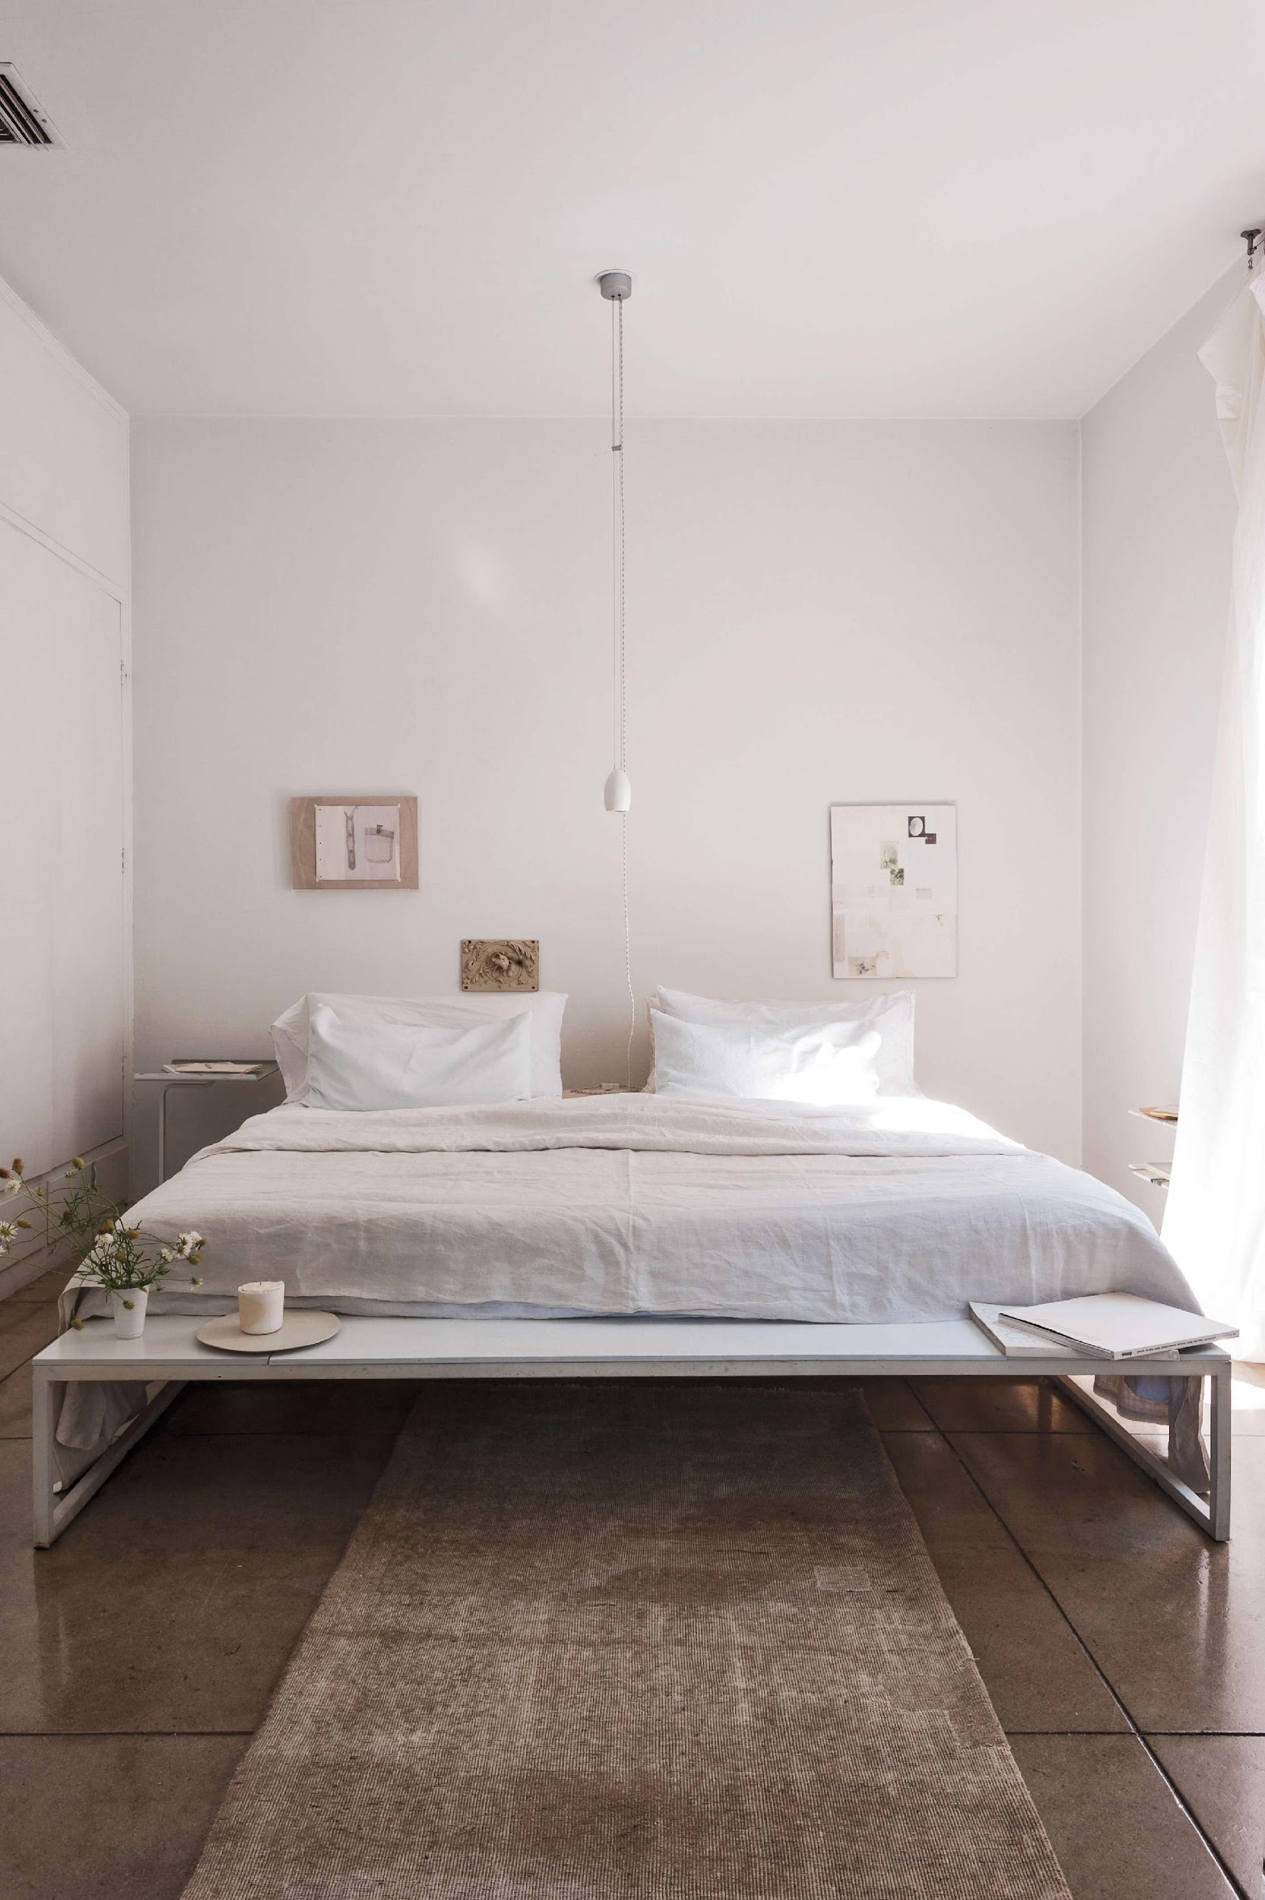
drop lights to emphasise height/volume
https://www.remodelista.com/posts/how-to-make-a-room-look-bigger-11-expert-tips/

Slide 5
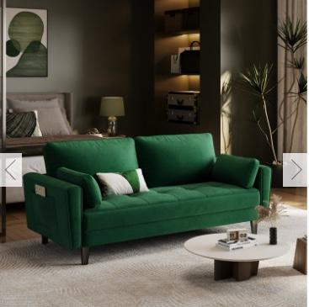
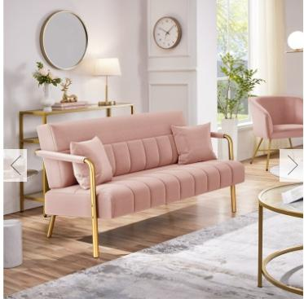
Budget friendly sofas
https://www.therange.co.uk/furniture/sofas-and-chairs/sofas/2-seater-upholstered-sofa-couch-with-2-pillows#6942626
£169.99
https://www.therange.co.uk/furniture/sofas-and-chairs/sofas/yaheetech-gold-metal-frame-sofa#5783767
£99

Slide 6
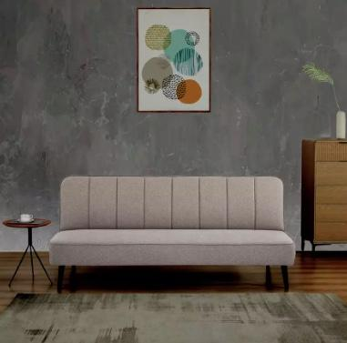
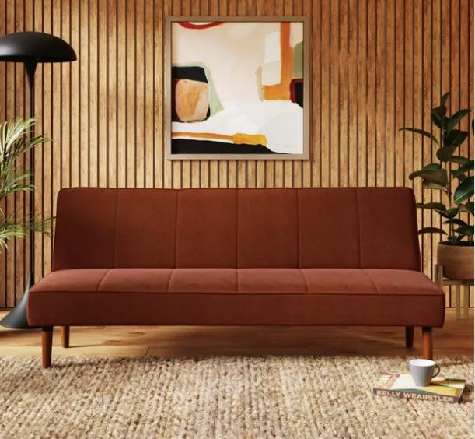
Budget friendly sofa beds
https://www.argos.co.uk/product/7763773?&utm_custom6=PLA&deeplink=true&gclsrc=aw.ds&&cmpid=GS001&_$ja=tsid:59157|acid:844-913-7556|cid:20358693262|agid:|tid:|crid:|nw:x|rnd:3090488883493935028|dvc:c|adp:|mt:|loc:9045999&utm_source=Google&utm_medium=cpc&utm_campaign=20358693262&utm_term=7763773&utm_content=shopping&utm_custom1=&utm_custom2=844-913-7556&GPDP=true&gad_source=1&gad_campaignid=19672037693&gclid=Cj0KCQiAiKzIBhCOARIsAKpKLANQwsXIEKWfMI-_OD7Rzp6Aqg3EtL1mcNxSYvt5xCSlVilgDg0oSrQaAsCbEALw_wcB
£168
https://www.dunelm.com/product/niko-velvet-clic-clac-sofa-bed-1000249321?defaultSkuId=30915222&utm_source=google&utm_medium=cpc&utm_campaign=Sofas_Sofa+Beds-PMax_%5BGOO-PLA-FURNUPHOLS-SOFABED%5D&gclsrc=aw.ds&gad_source=1&gad_campaignid=19822800188&gclid=Cj0KCQiAiKzIBhCOARIsAKpKLAPWXib8ZHnYnE7CsZrZ6RooErA-Bn_blQLMRKhwEHE9E4ER4xrAXTIaAqqQEALw_wcB
£199

Slide 7
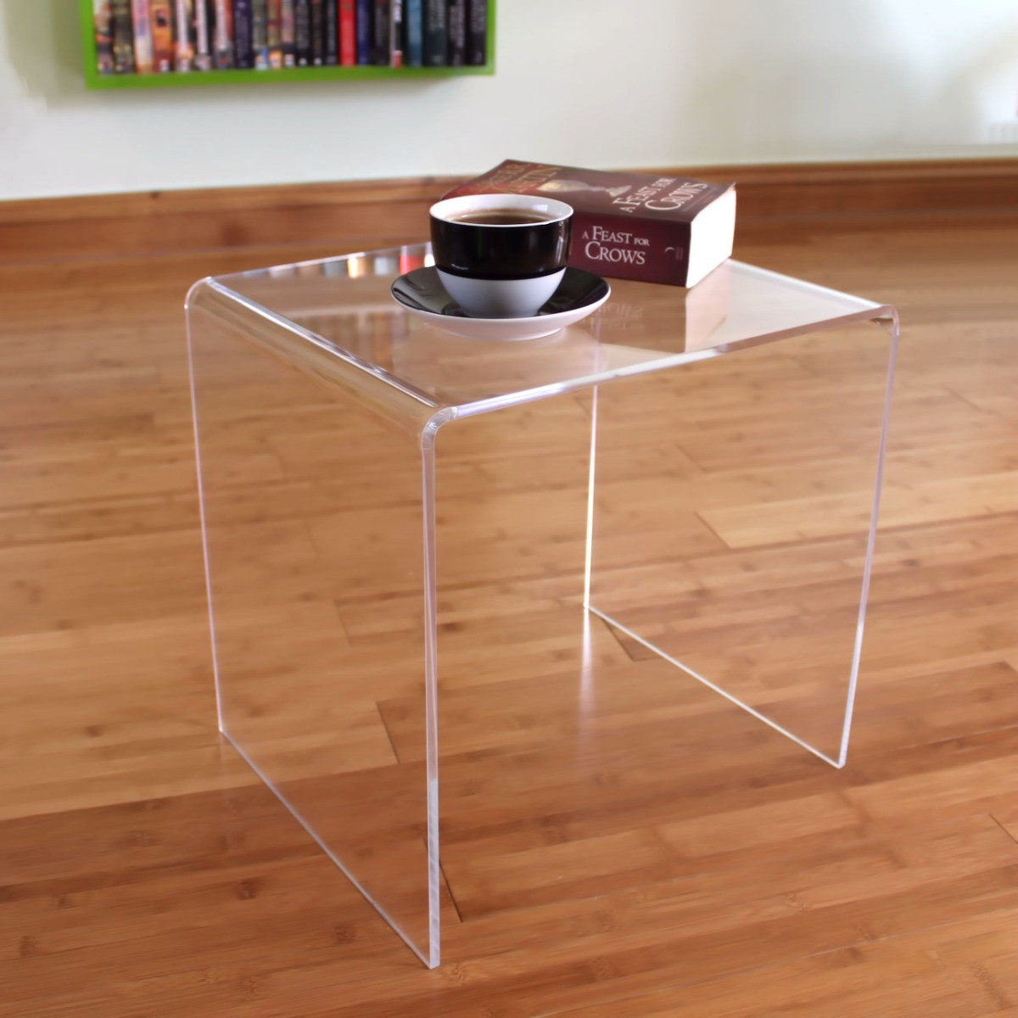
Glass/acrylic tables
https://www.tielo.co.uk/side-tables-clear.html
£55.45
Notes:
Glass/acrylic tables,
Emphasize vertical – full length curtain,
Proportions – furniture size to room size
more lighting across the space like lamps

Slide 8
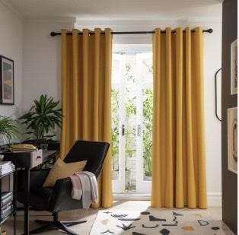
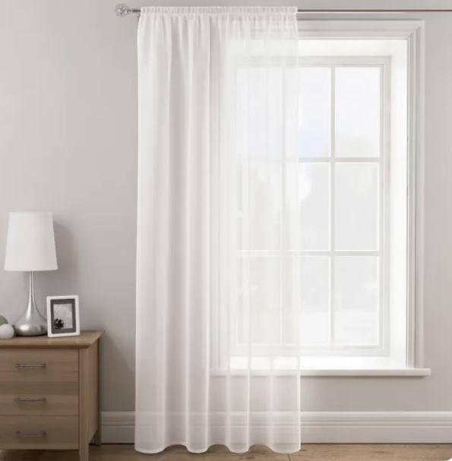
Budget friendly curtains
https://www.dunelm.com/product/sheer-elegance-slot-top-single-voile-panel-1000112084?defaultSkuId=30437595&branchCode=0045&utm_source=google&utm_medium=cpc&utm_campaign=Curtains_Curtains-PMax_%5BGOO-LIA-CURTAINS-CURTAINS%5D&gclsrc=aw.ds&gad_source=1&gad_campaignid=19822794200&gclid=Cj0KCQiAiKzIBhCOARIsAKpKLAOvYttQznJcjarMTZ-C7J8QLq3rwiqUoJ9c3z0CXrSSjsoZWCNzVYEaAq1kEALw_wcB
£4
https://www.habitat.co.uk/product/9616897?utm_source=google&utm_medium=free_listing&utm_campaign=merchant_center
£11.29

Slide 9
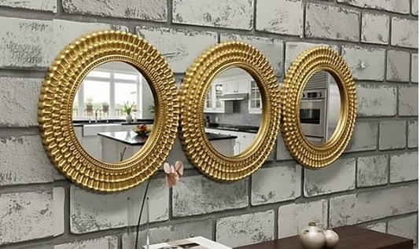
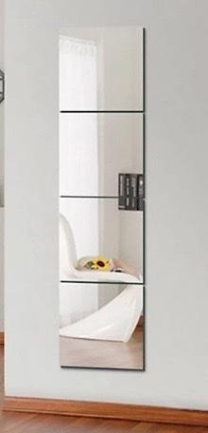
Budget friendly mirrors
https://www.diy.com/departments/biznest-set-of-3-moroccan-style-round-wall-mounted-mirror-intricate-gold-metallic-finish-frame-art-deco-pattern-interior-26-cm-dia/5061109230267_BQ.prd
£11.99
https://www.diy.com/departments/set-of-4-square-frameless-wall-mirror-tiles-400-x-400-mm/0735940249461_BQ.prd
£16.56

Slide 10
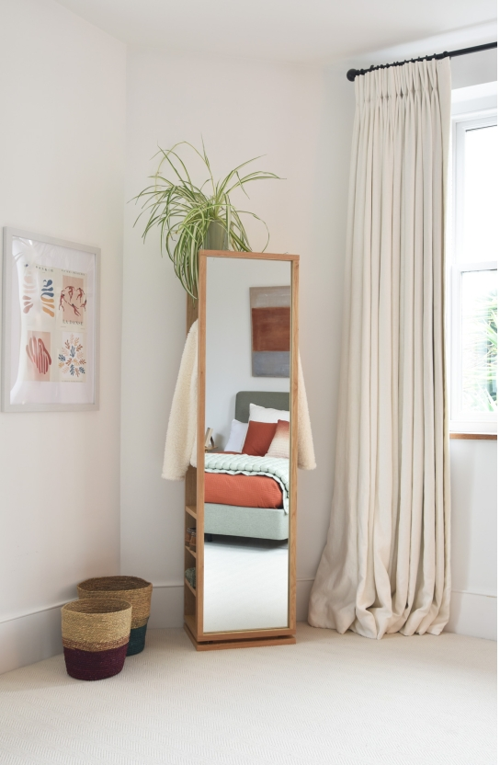
mirror and storage
£249.00
https://www.futoncompany.co.uk/shop-by-product/organise/hallway-furniture/oak-storage-floor-mirror-v3.html

Slide 11
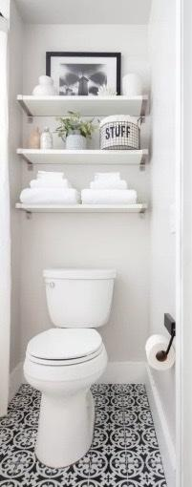
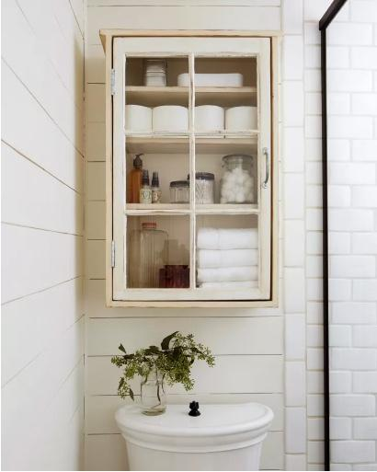
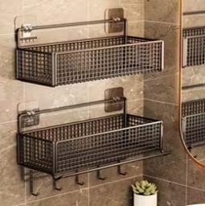
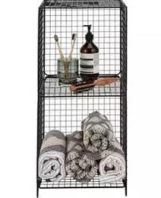
Vertical storage ideas

Slide 12
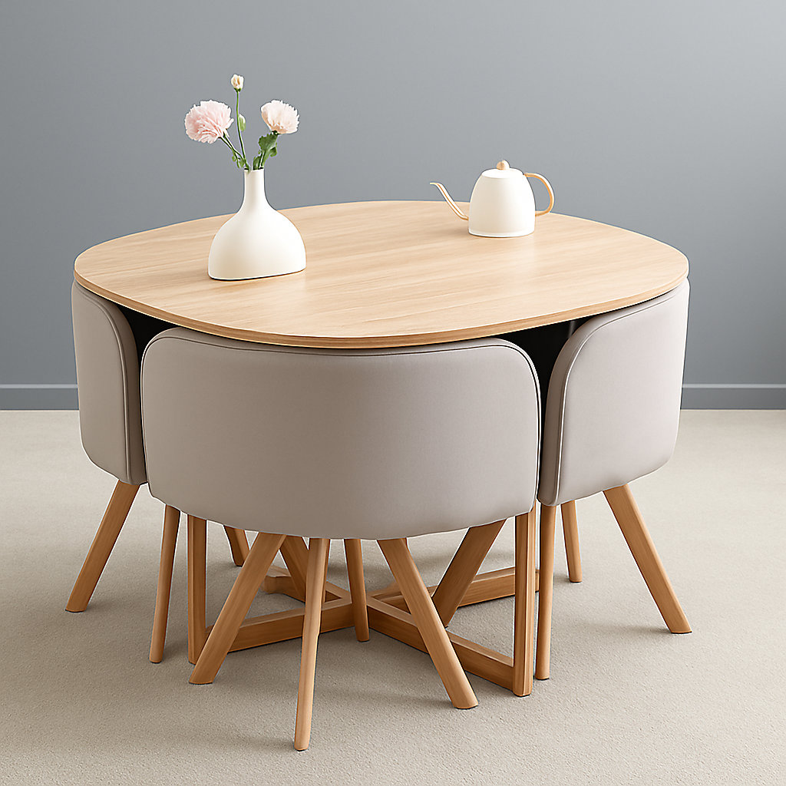
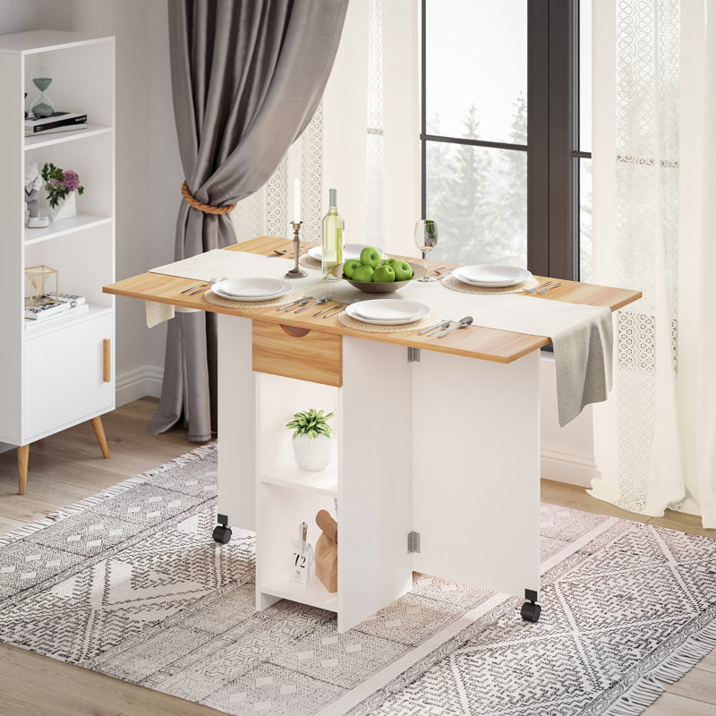
Space/Storage Hacks
Movable Furniture - COMPACT
https://media.diy.com/is/image/KingfisherDigital/space-saving-dining-table-with-4-velvet-chairs-set-dining-room-furniture~5061055341536_01c_MP?$MOB_PREV$&$width=1200&$height=1200
https://www.wayfair.co.uk/home/pdp/ebern-designs-friedhorst-trestle-dining-table-u004022811.html?piid=745601691%2C746534470

Slide 13
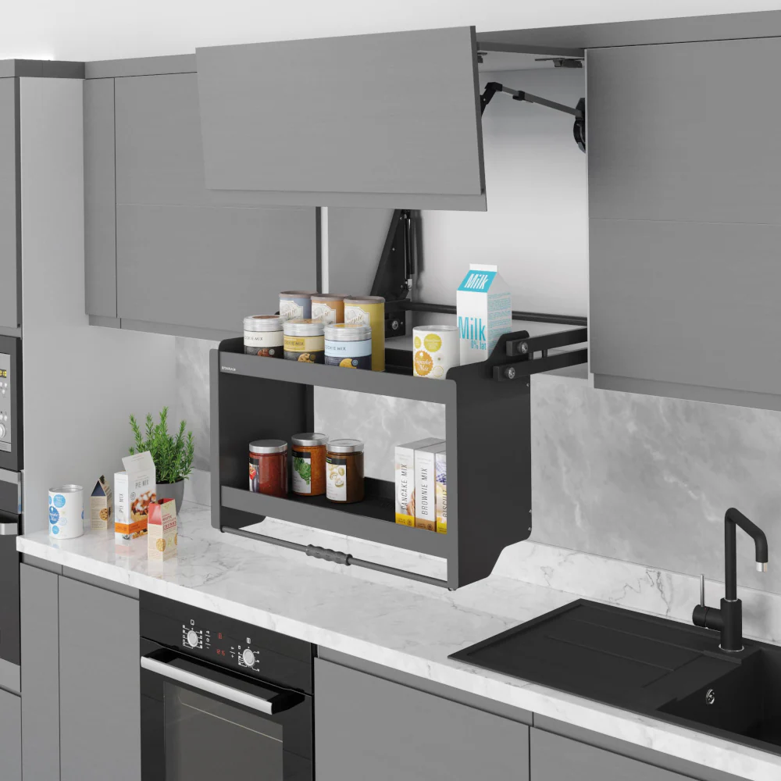
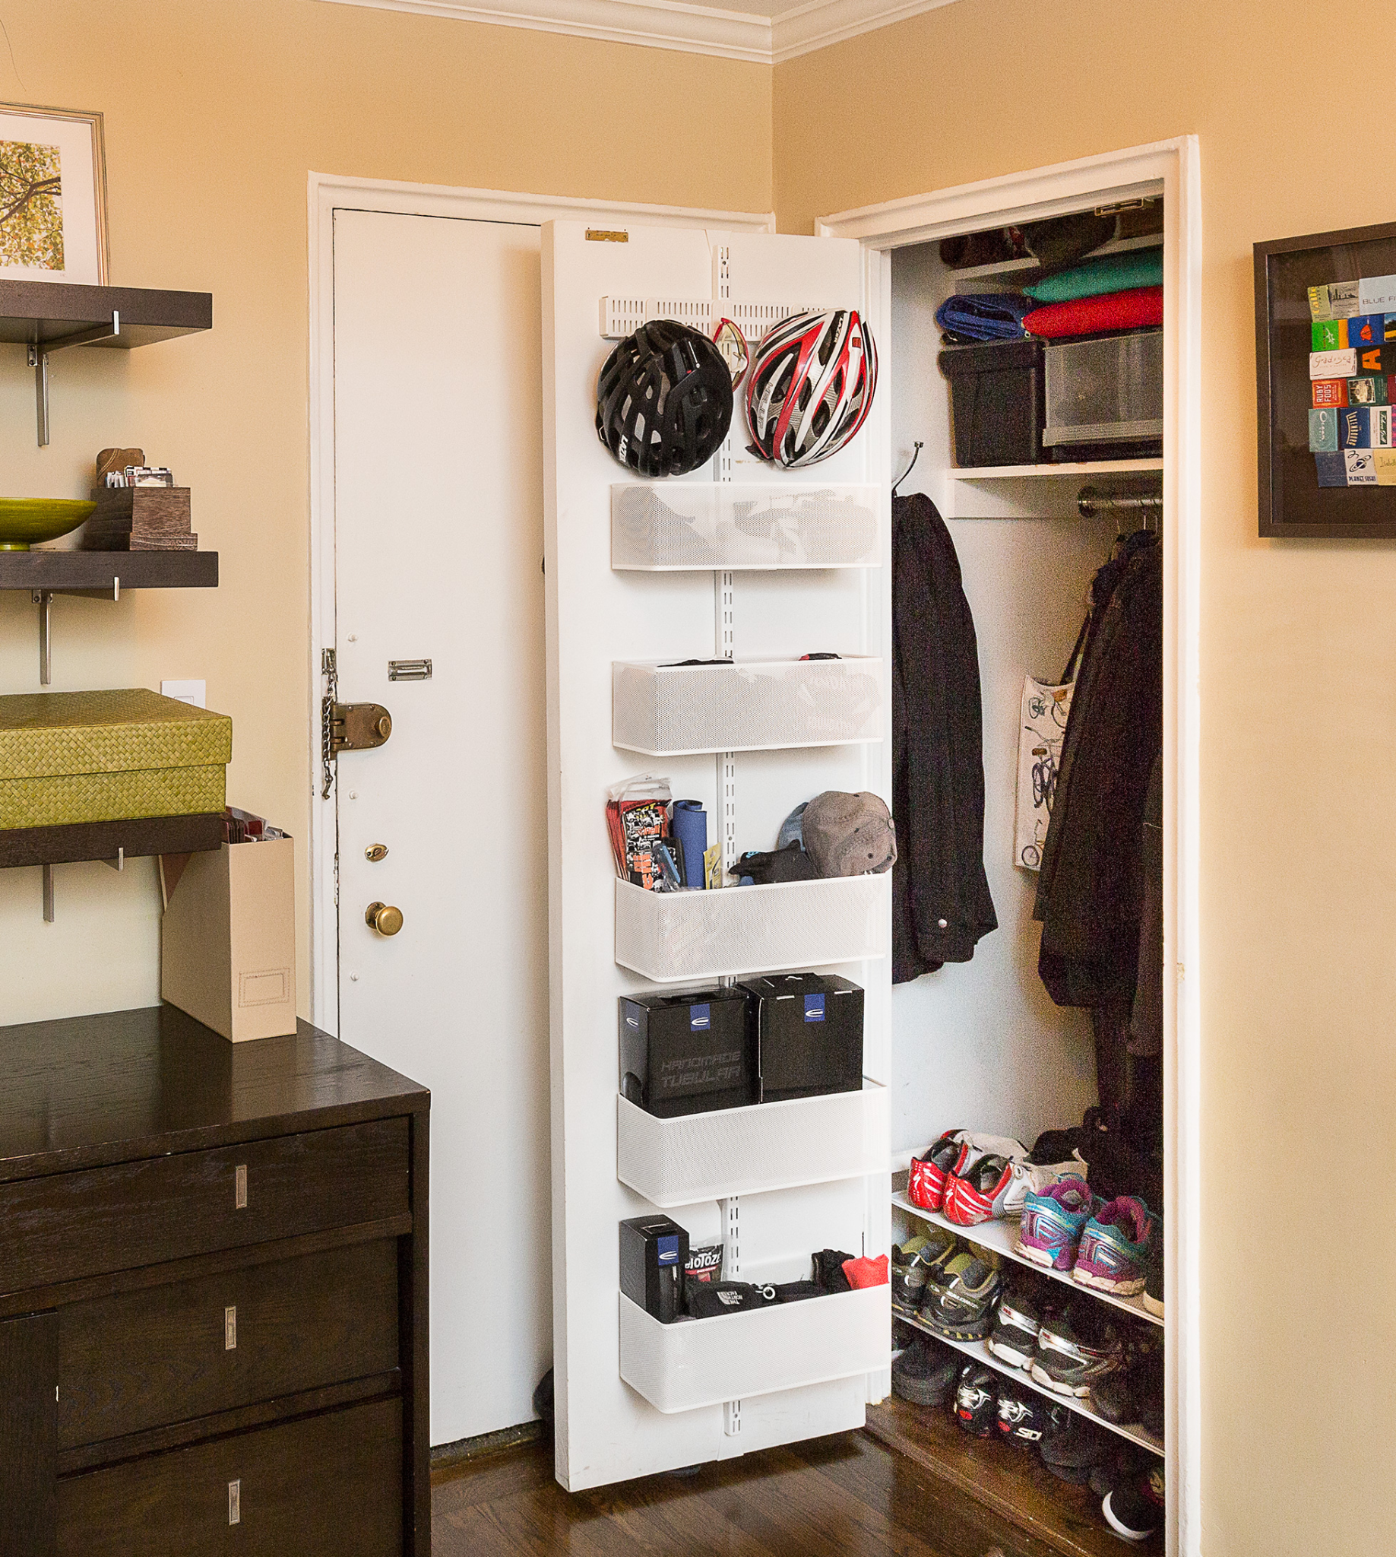
Space/Storage Hacks
£149.99
https://www.amazon.co.uk/FittingsCo-Pull-Down-Anti-Slip-Cabinets-Anthracite/dp/B09NM8JHTZ?th=1
https://www.houselogic.com/organize-maintain/storage-ideas-hacks/storage-solutions-for-small-spaces-from-new-yorkers/; Anne Ruthmann for HouseLogic

Slide 14
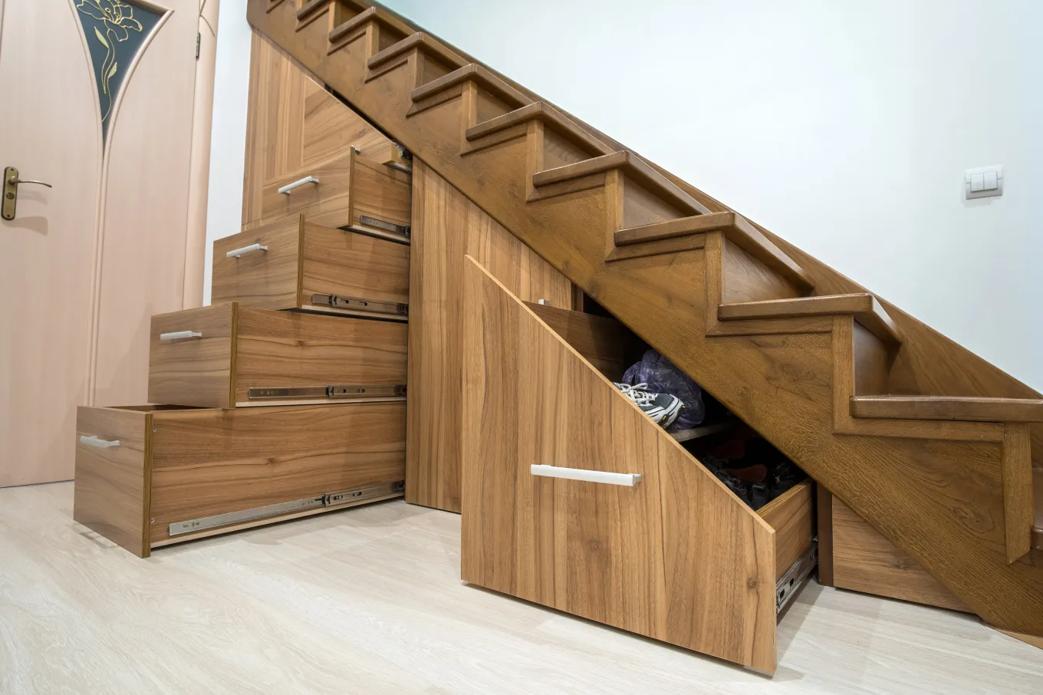
https://www.houselogic.com/organize-maintain/storage-ideas-hacks/home-trends-to-watch-in-2025/

Slide 15
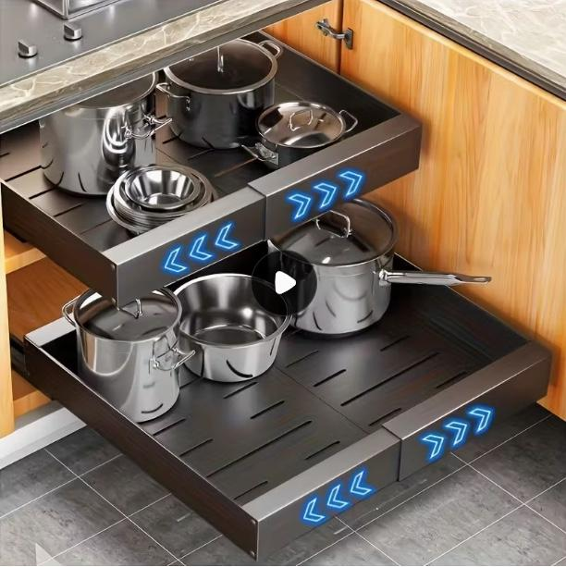
Cabinet organisation
https://www.temu.com/uk/expandable-heavy-duty-carbon-steel-kitchen-with--sliding-drawers-white-modern--organizer-adjustable-shelves-expandable-design-for-pantry-bathroom--saving-vertical-cabinet-no-locks-needed-g-601103393268865.html?_oak_name_id=4311395050292739759&_oak_mp_inf=EIHJ6tG01ogBGiAyMDM2YTE3ZmRjZWQ0MjE4OWJjMDdmNDRjYTM2OWQ1YyD249%2BppTM%3D&top_gallery_url=https%3A%2F%2Fimg.kwcdn.com%2Fproduct%2Fopen%2Fde7724ce313a4d80982267891a1311ae-goods.jpeg&spec_gallery_id=21936126268&refer_page_sn=10009&refer_source=0&freesia_scene=2&_oak_freesia_scene=2&_oak_rec_ext_1=MTI4Nw&_oak_gallery_order=1721881488%2C49327872%2C1330821774%2C316495053%2C1322191766&search_key=kitchen%20cabinet%20storage&refer_page_el_sn=200049&_x_sessn_id=53ydab9hjl&refer_page_name=search_result&refer_page_id=10009_1762366322567_nr4t4dol3q
£12.87
Notes:
https://www.temu.com/uk/expandable-heavy-duty-carbon-steel-kitchen-with--sliding-drawers-white-modern--organizer-adjustable-shelves-expandable-design-for-pantry-bathroom--saving-vertical-cabinet-no-locks-needed-g-601103393268865.html?_oak_name_id=4311395050292739759&_oak_mp_inf=EIHJ6tG01ogBGiAyMDM2YTE3ZmRjZWQ0MjE4OWJjMDdmNDRjYTM2OWQ1YyD249%2BppTM%3D&top_gallery_url=https%3A%2F%2Fimg.kwcdn.com%2Fproduct%2Fopen%2Fde7724ce313a4d80982267891a1311ae-goods.jpeg&spec_gallery_id=21936126268&refer_page_sn=10032&refer_source=0&freesia_scene=2&_oak_freesia_scene=2&_oak_rec_ext_1=MTI4Nw&_oak_gallery_order=1721881488%2C49327872%2C1330821774%2C316495053%2C1322191766&search_key=kitchen%20cabinet%20storage&refer_page_el_sn=200049&refer_page_name=goods&refer_page_id=10032_1762376893414_q4b1kkg0qb&_x_sessn_id=53ydab9hjl

Slide 16
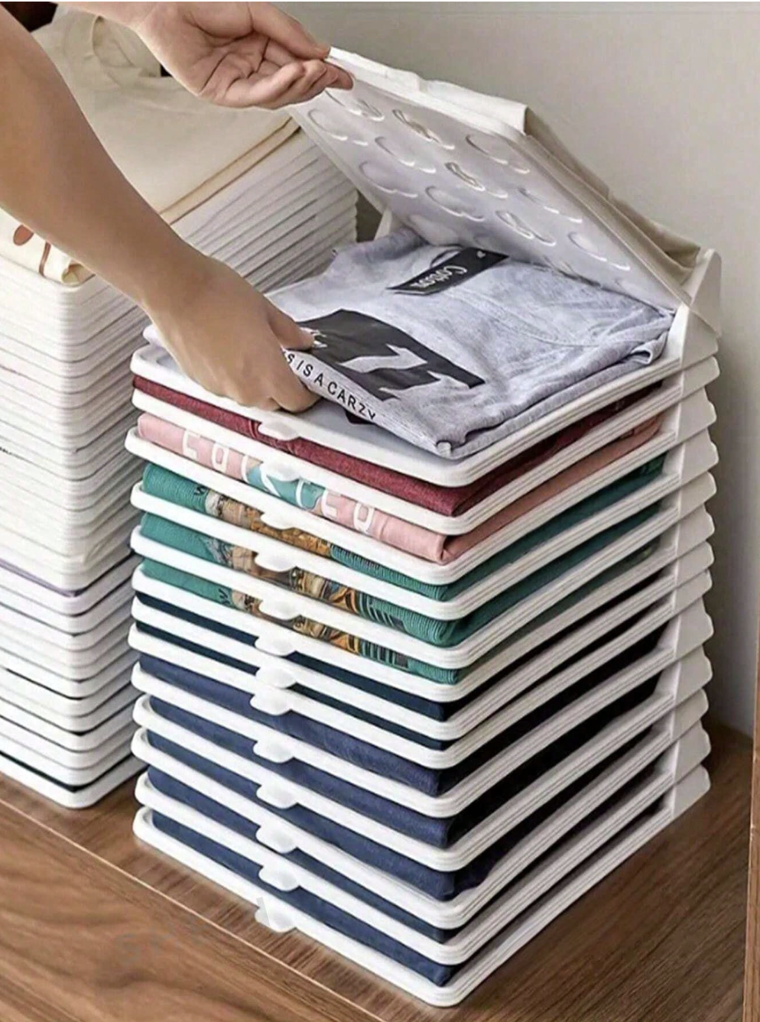
Innovative Space and Space Saving ideas
£15.54 per 10 pieces
https://www.shein.co.uk/1-5/10/20PiecesCollapsibleClothesOrganizer,StackableSpaceSavingShirtAndPantsSortingStorageRackWithLidHouseholdKitchenBasketBoxes,EasyToAccess,Clutter-Free,BinsAndContainersForHomeOrganization,LaundryOrganizationAndStorage-p-141547748-cat-3542.html?share_from=null&cdn_rsite=cf&ref=www&rep=dir&ret=uk
https://www.happybeds.co.uk/catalogsearch/result/?q=high%20sleeperSearch results for: 'high sleeper'

Slide 17
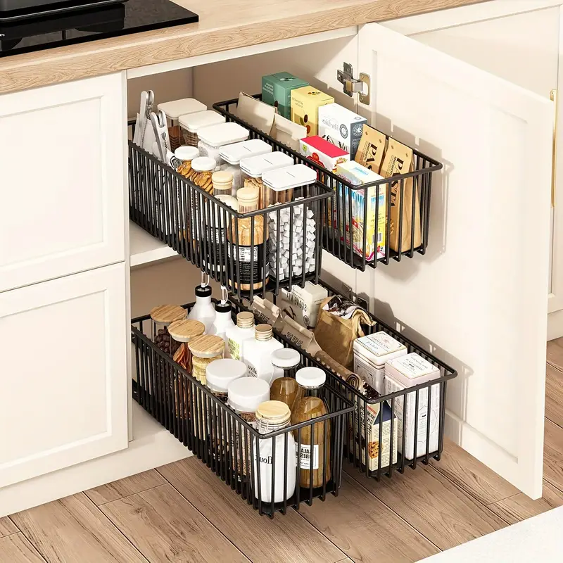
Innovative Space and Space Saving ideas
£10.81 per piece
https://www.temu.com/goods.html?_bg_fs=1&pic_h=1500&pic_w=1500&refer_share_id=PR6AlZdVjE9WbxPrzhWy4w9ZERubGnHV&refer_share_channel=whatsapp_chat&thumb_url=https%3A%2F%2Fimg.kwcdn.com%2Fproduct%2Fopen%2F20fcc7a44534479e83a16647d0d76cde-goods.jpeg&from_share=1&goods_id=601101770841678&_oak_page_source=417&_oak_region=210&refer_share_suin=RSSBCP73WMSSDU4ARZQGA35Z4PIBCDEHF44DKAGE54C5EVDXD4E46CCL7RZAODOGI4NPGZL37Q&locale_override=210%7Een%7EGBP&share_img=https%3A%2F%2Fimg-eu.kwcdn.com%2Fgoods-detail-img%2F35b7c2%2FyeUWmfsNGd%2Fe905da73cd284236a1dd58301d80ec66.png&share_ui_type=1&_oaksn_=J92FrWuHZJ815i60O6rclCiqFq1ksadL4OXMyADAXqg%3D
https://www.happybeds.co.uk/catalogsearch/result/?q=high%20sleeperSearch results for: 'high sleeper'

Slide 18
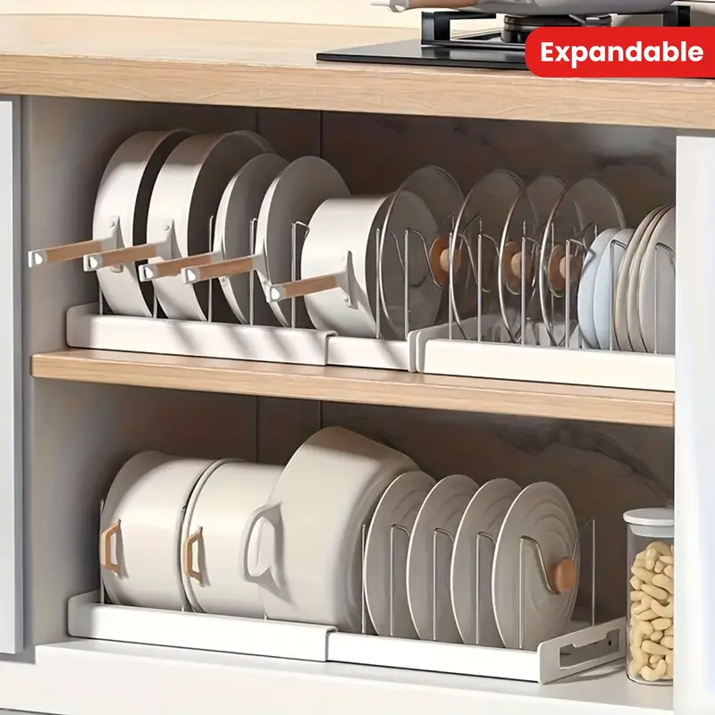
Innovative Space and Space Saving ideas
£8.79 per piece
https://www.temu.com/goods.html?_bg_fs=1&refer_share_id=ZCIeox9JpzPoNsm1zLoksFxlDI76P4fO&refer_share_channel=whatsapp_chat&from_share=1&goods_id=601100777998522&_oak_page_source=417&_oak_region=210&refer_share_suin=RSSBBPNOT4SXNQ2Q2JQGA35Z4PIBCDEHF44DKAGE54C5EVDWCJ7UQTXQUEYBKWJO7FJSRLYHLY&share_img=https%3A%2F%2Fimg-eu.kwcdn.com%2Fgoods-detail-img%2F35b7c2%2FyeUWmfsNGd%2F33712a53dd3d43ccb96f908943946873.png&share_ui_type=1&_oaksn_=zk3LeGtDBcXfZ85sJbH5A%2FC57cZkaBrPl%2FbMipHk19c%3D
https://www.happybeds.co.uk/catalogsearch/result/?q=high%20sleeperSearch results for: 'high sleeper'

Slide 19
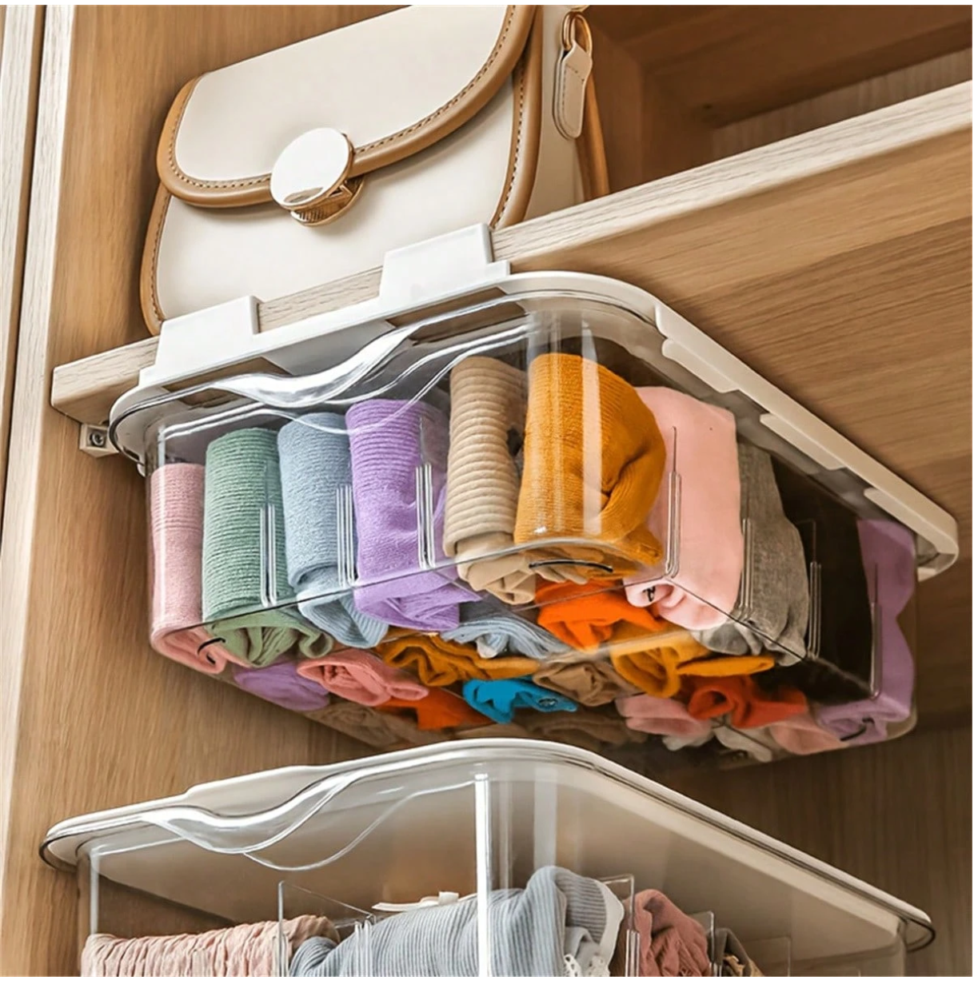
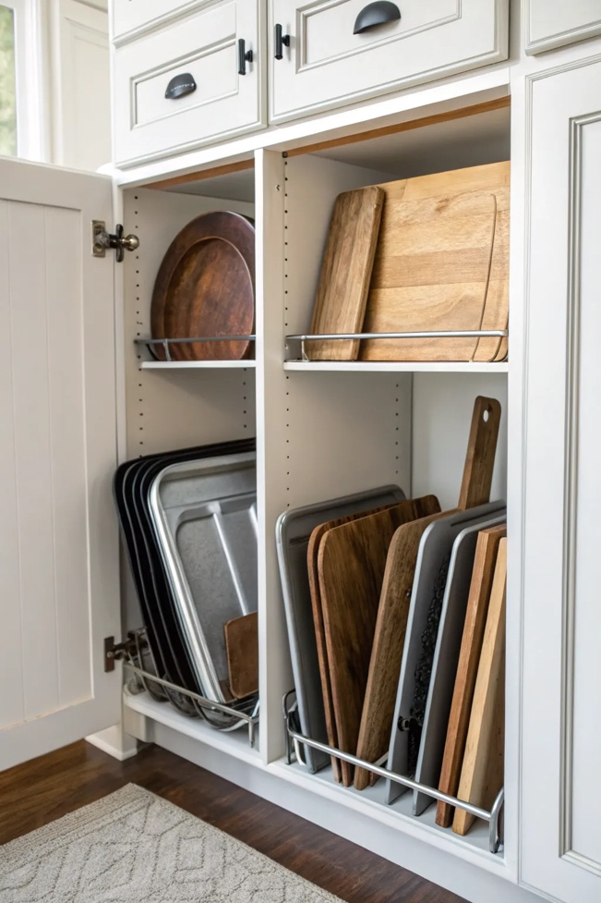
£19.38
https://www.shein.co.uk/goods-p-144130117.html?goods_id=144130117&test=5051&url_from=PINADSDPA&scene=1&pf=pinterest&ad_type=DPA&language=en&siteuid=uk&landing_page_id=1510&ad_test_id=0&requestId=ssr-c2c83eafc508af34&link_type=link
https://casolia.com/ideas-to-maximize-kitchen-cabinet-space/ [lots of ideas here]
https://www.happybeds.co.uk/catalogsearch/result/?q=high%20sleeperSearch results for: 'high sleeper'

Slide 20
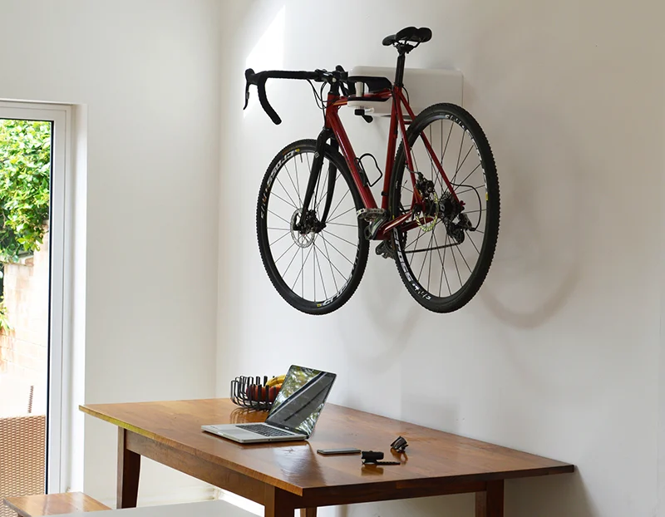
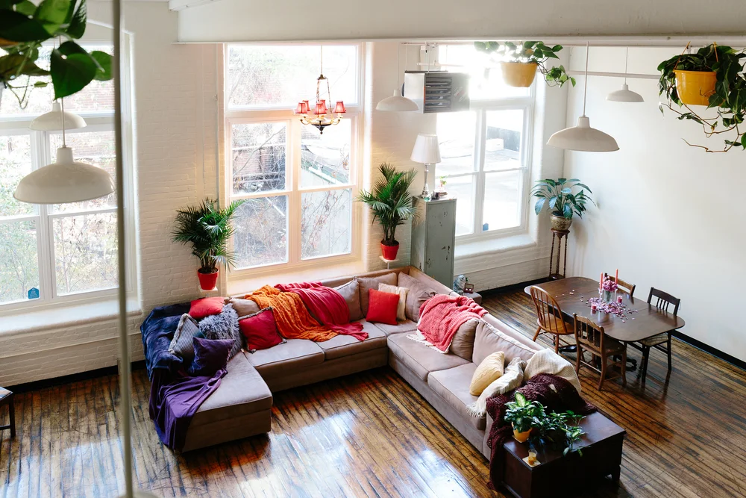
Space/Storage Hacks
Smaller appliances and fixtures, ‘Lighter’ furniture, Mirrors to improve depth and lighting , ‘Light and Airy’ colour scheme, Movable Furniture, Innovative Storage solutions, unused areas – WALLS, CEILING
https://www.evanscycles.com/brand/hiplok/airlok-708910
http://annaspaller.com/wxelhglv0gio5p8omtjqlk8j5fxgvf
£145
Notes:
add bathroom dead spaces for storage - under the bath

Slide 21
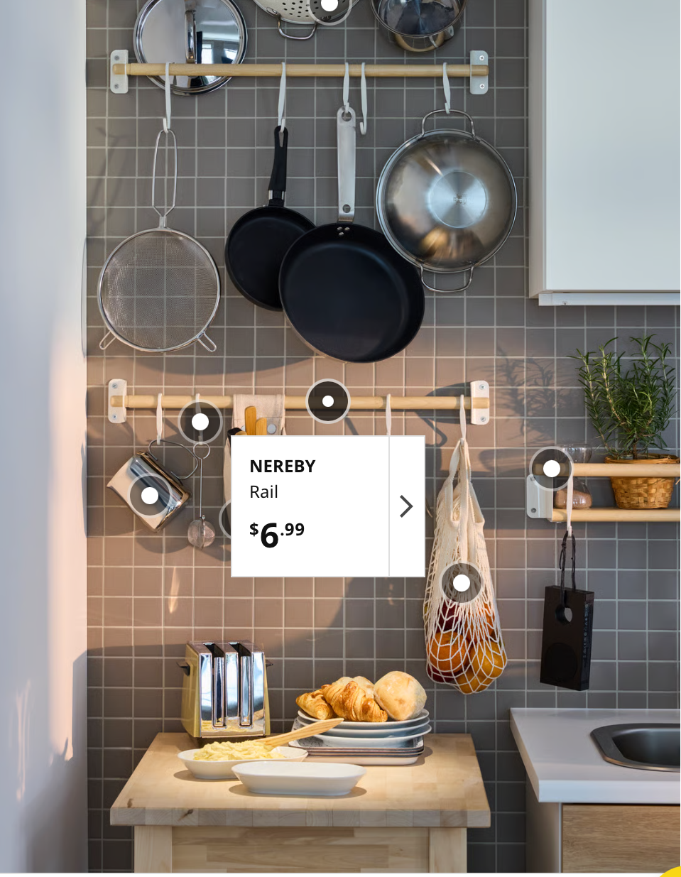
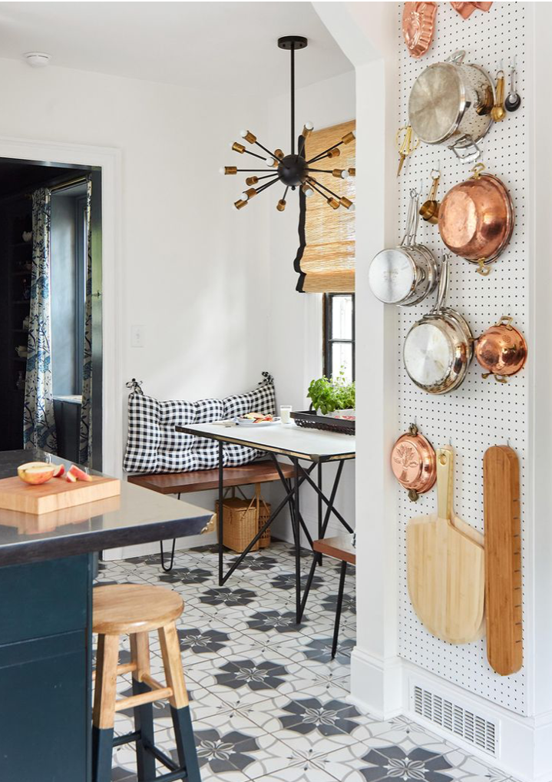
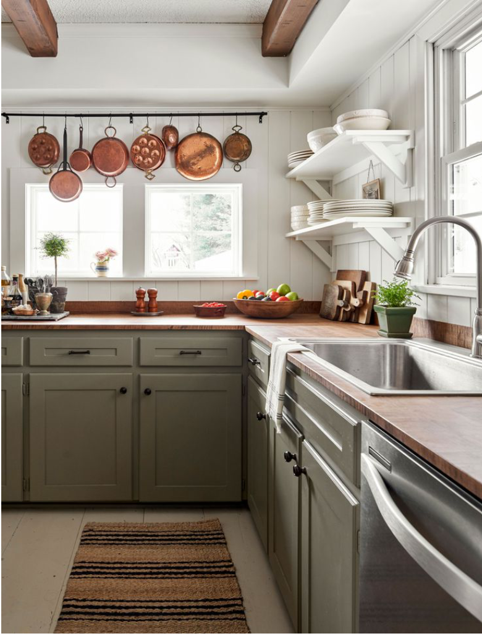
Space/Storage Hacks
Smaller appliances and fixtures, ‘Lighter’ furniture, Mirrors to improve depth and lighting , ‘Light and Airy’ colour scheme, Movable Furniture, Innovative Storage solutions, unused areas - WALLS
https://www.ikea.com/gb/en/rooms/kitchen/how-to/maximising-kitchen-space-for-more-room-to-cook-pub05155f10/
https://moodsinteriortrends.com/trends/cottagecore-trend-a-rustic-revival-in-interior-design/
https://www.facebook.com/groups/1706748102970911/posts/2933888666923509/

Slide 22
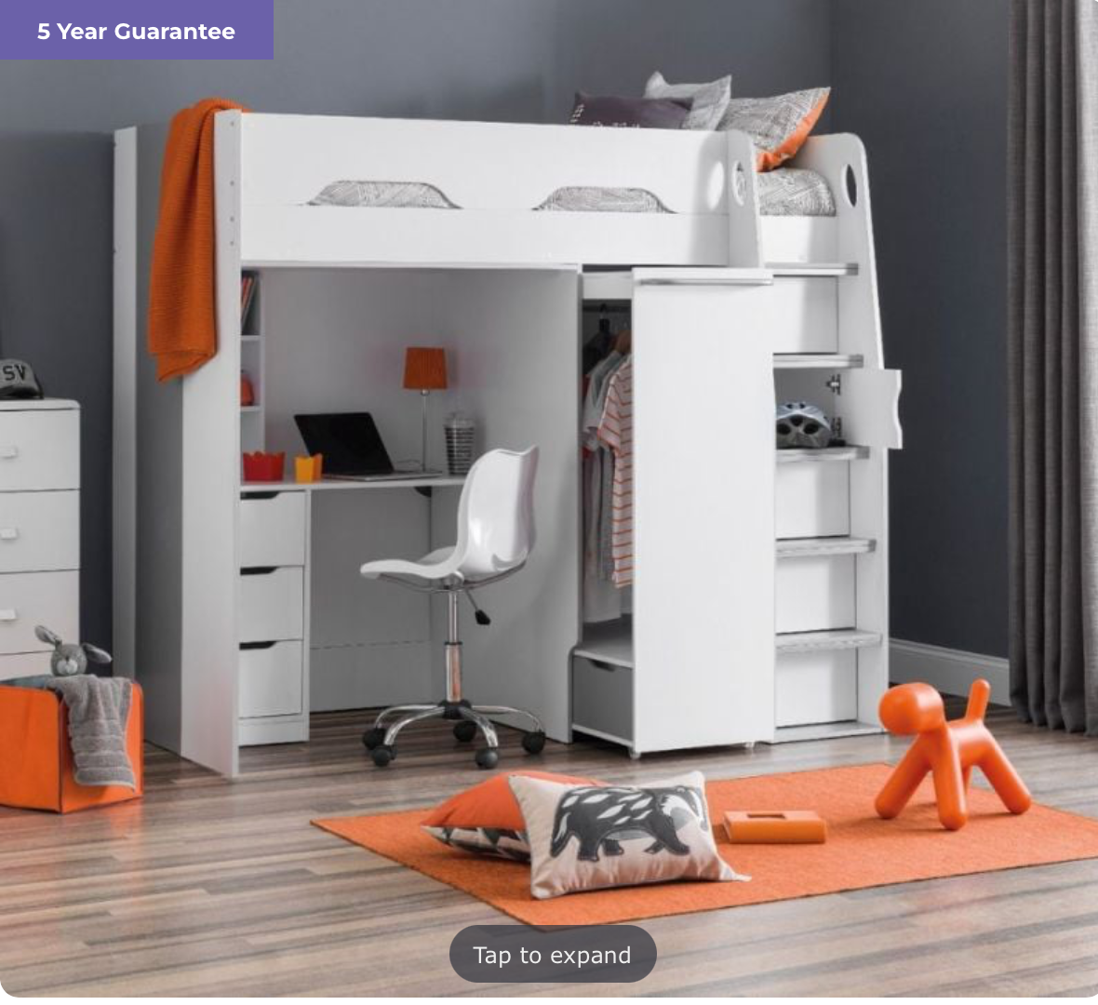
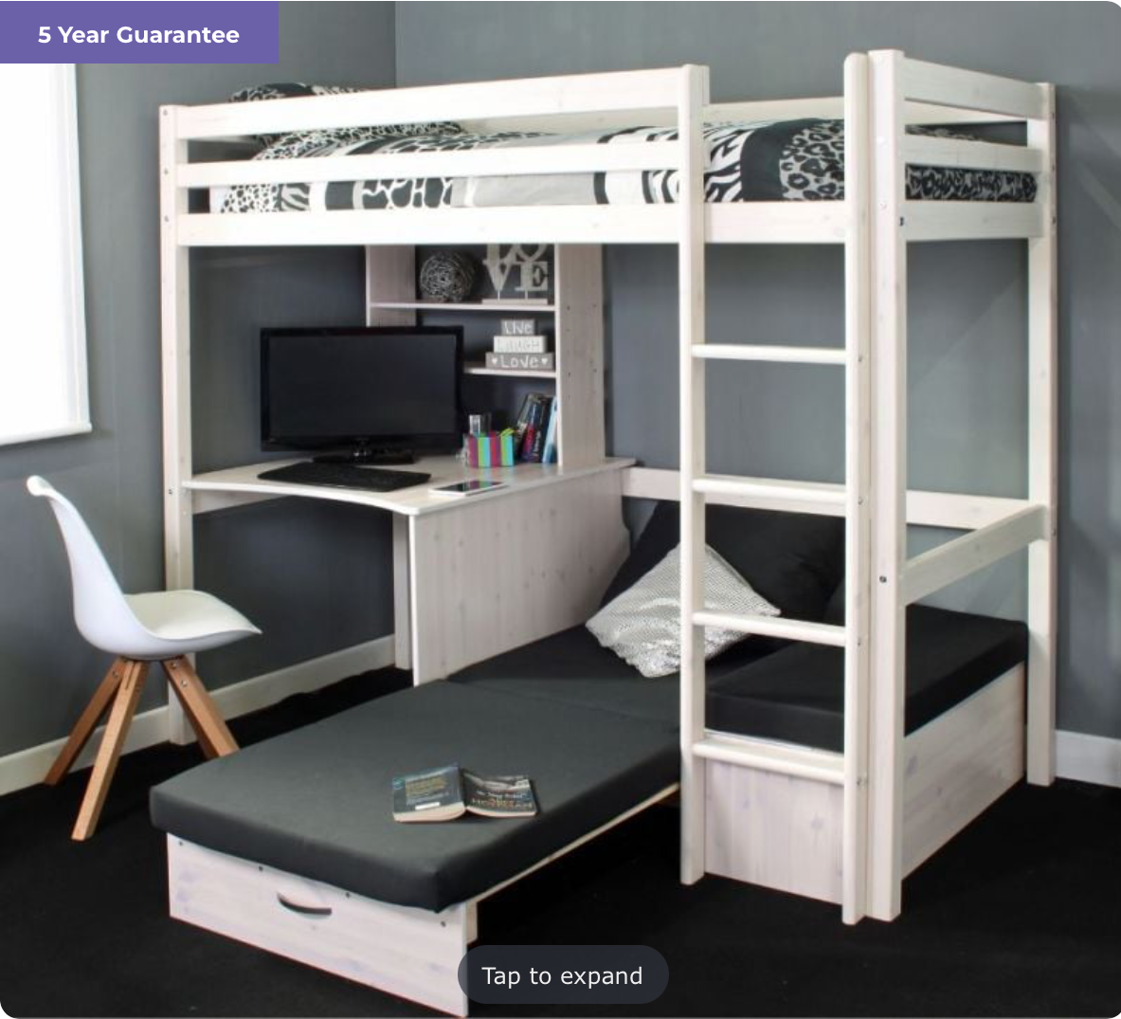
Innovative Space and Space Saving ideas
https://www.happybeds.co.uk/catalogsearch/result/?q=high%20sleeperSearch results for: 'high sleeper'
https://www.happybeds.co.uk/catalogsearch/result/?q=high%20sleeperSearch results for: 'high sleeper'

Slide 23
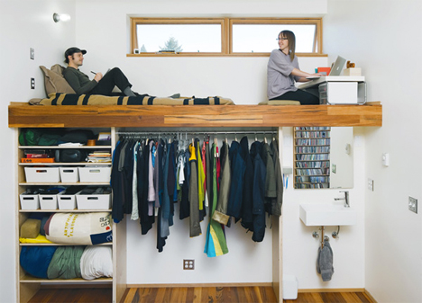
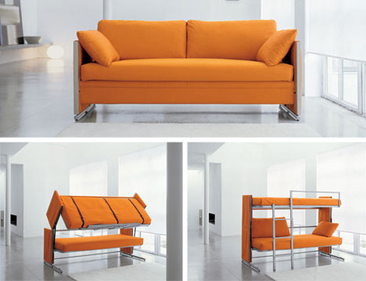
Innovative Space and Space Saving ideas
https://www.happybeds.co.uk/catalogsearch/result/?q=high%20sleeperSearch results for: 'high sleeper'

Slide 24
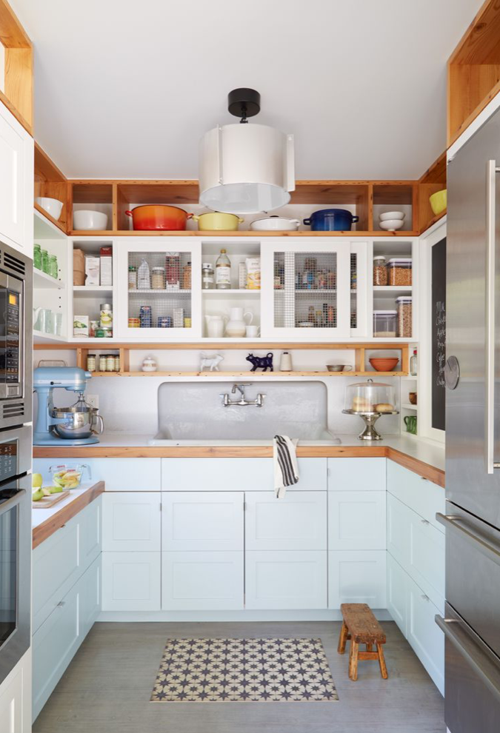
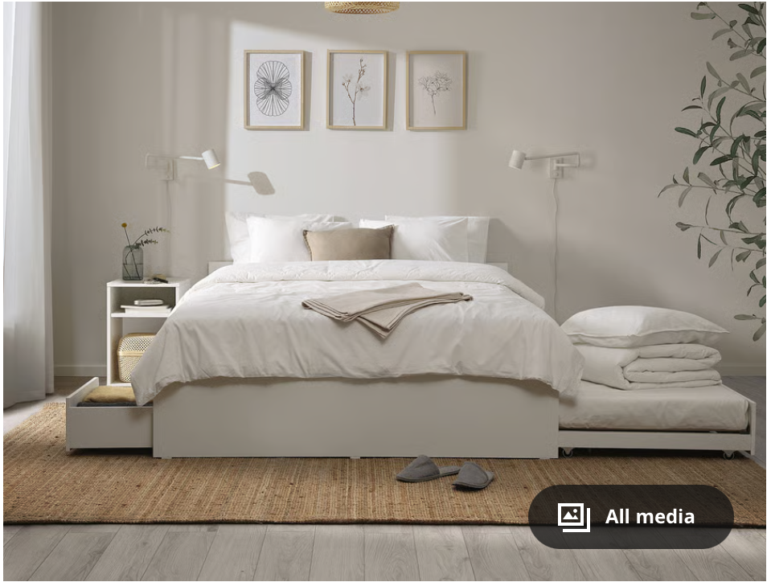
Innovative Space and Space Saving ideas
https://www.happybeds.co.uk/catalogsearch/result/?q=high%20sleeperSearch results for: 'high sleeper'

Slide 25
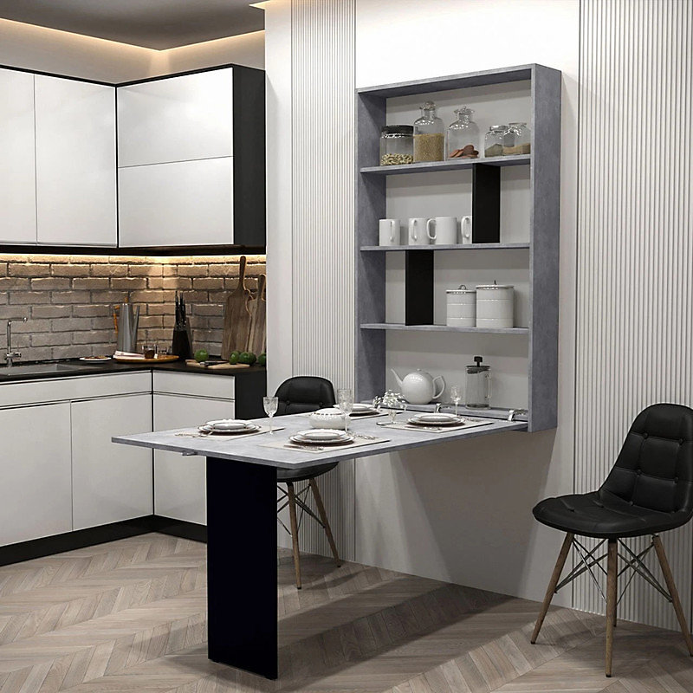
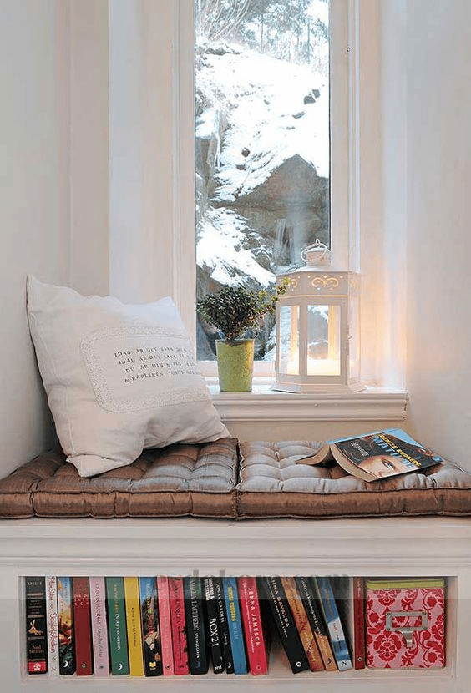
Structural/Layout Hacks
Smaller appliances and fixtures, ‘Lighter’ furniture, Mirrors to improve depth and lighting , ‘Light and Airy’ colour scheme, Movable Furniture, Innovative Storage solutions, unused areas, open-plan and partitions, integrated with building structure
https://www.diy.com/departments/wall-mounted-foldable-kitchen-table-abi-cabinet-in-modern-concrete-black-space-saving-design/5906647835782_BQ.prd
https://onekindesign.com/window-nook-framing-spectacular-views/

Slide 26
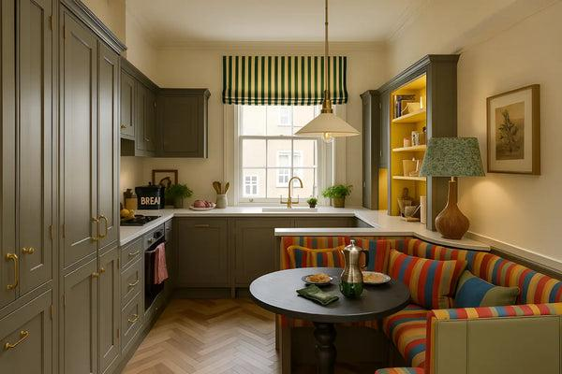
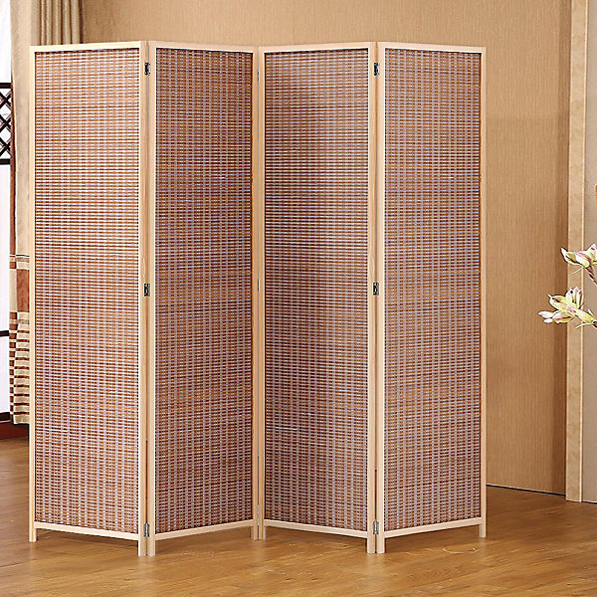
Structural/Layout Hacks
Smaller appliances and fixtures, ‘Lighter’ furniture, Mirrors to improve depth and lighting , ‘Light and Airy’ colour scheme, Movable Furniture, Innovative Storage solutions, unused areas, open plan and partitions, integrated with building structure
https://www.diy.com/departments/4-panel-brown-folding-room-divider-indoor-privacy-screen-room-partition-200cm-w-x-180cm-h-/0735940250757_BQ.prd
https://dreamhomestore.co.uk/blogs/inspiration/open-kitchen-dining-room-ideas-uk

Slide 27
Temporal Hacks
Assign spaces for different activities
Dedicating spaces for recurring, habitual activity
Explore multiple activities that can be done in a room/space
Assign multiple activities identified across different times of the day
Assign people to different tasks / times

Slide 28
CONSIDER ALL AREAS/ROOMS at home: Bedroom, Living Rooms, Bath, Kitchen, Balcony, Storage
CONSIDER SOLUTIONS THAT ARE: LOW / MEDIUM / HIGH on Effort, Cost, Permanence
CONSIDER SOLUTIONS COVERING:
Decorations, Objects,
Furniture and Fixtures
Structural features and layout alterations

Slide 29



Neurodivergence and overcrowding
Neurotypical ways of thinking, behaving and interacting are deeply embedded as the right or better way of existing that it goes unchallenged.

Slide 30
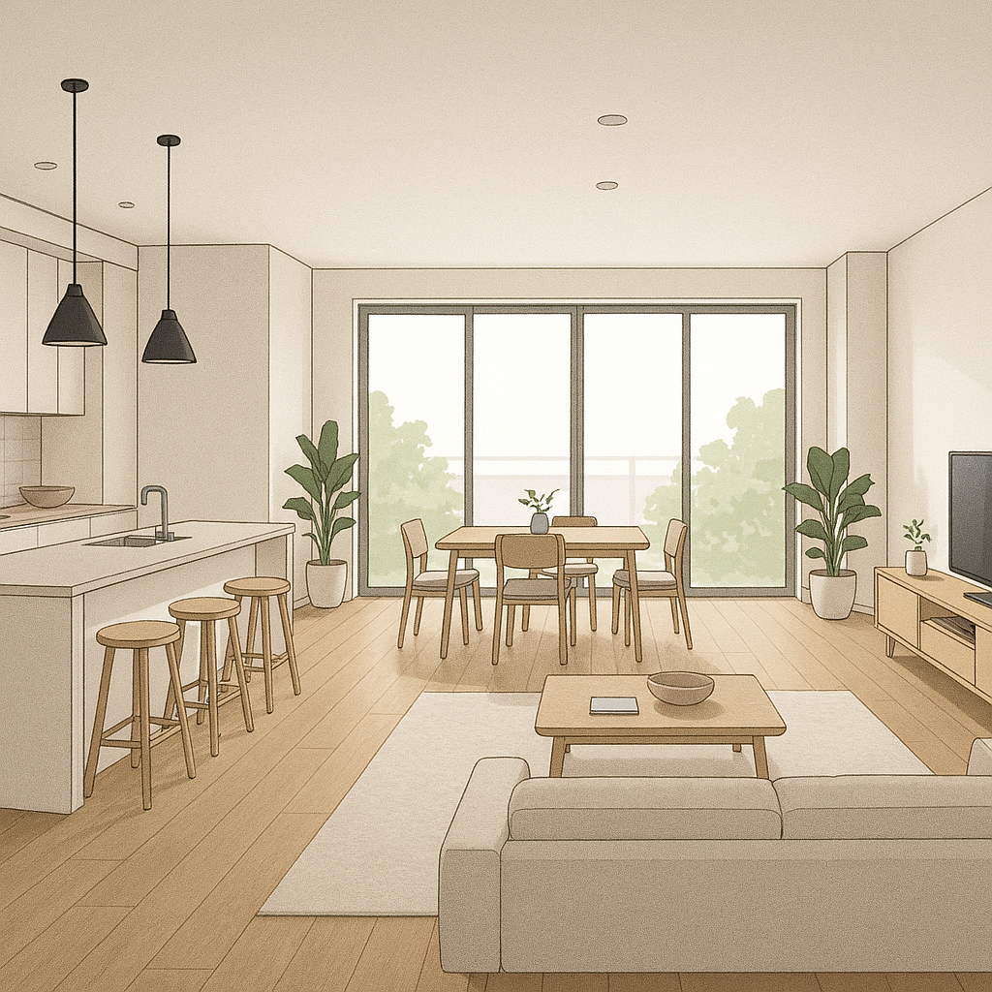
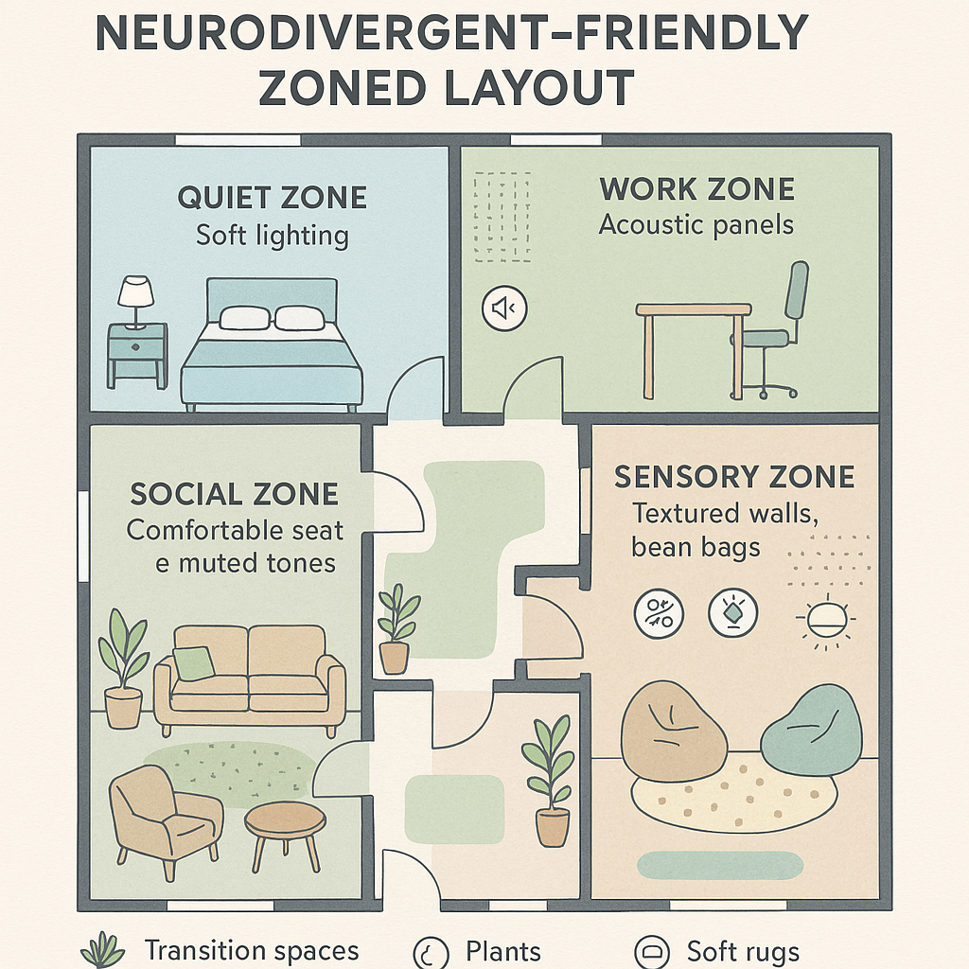
Who do we build for?
Modern open-plan layout
spaces likes kitchens and living rooms flow together without transitional zones because there is an assumption of acceptance/tolerance of constant visual and auditory stimuli
zones for low stimulation and retreat
zones for work/study to minimise distraction
innovative inclusion of soft furnishing to absorb sounds

Slide 31
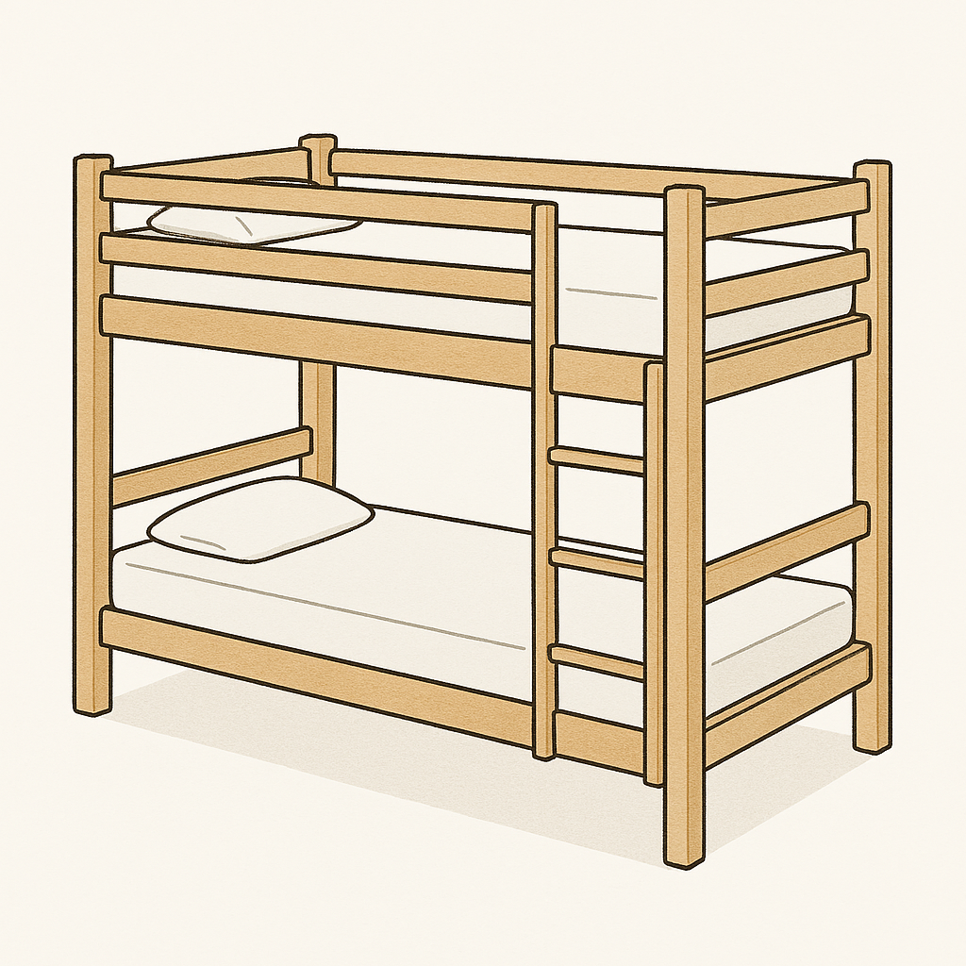

No difference

